Slide 1
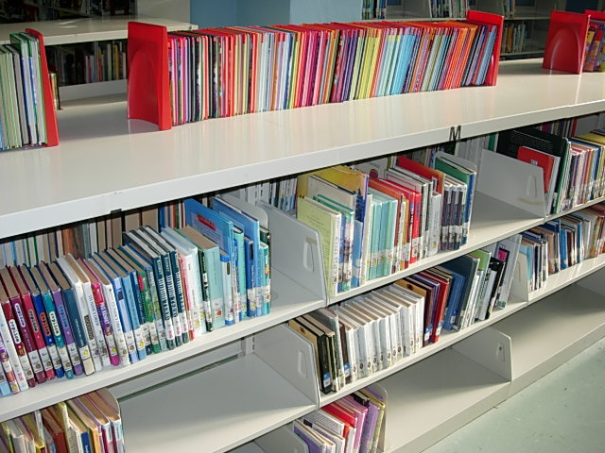
There’s more to our library than just books

Slide 2

A lot of our library is online

Slide 3
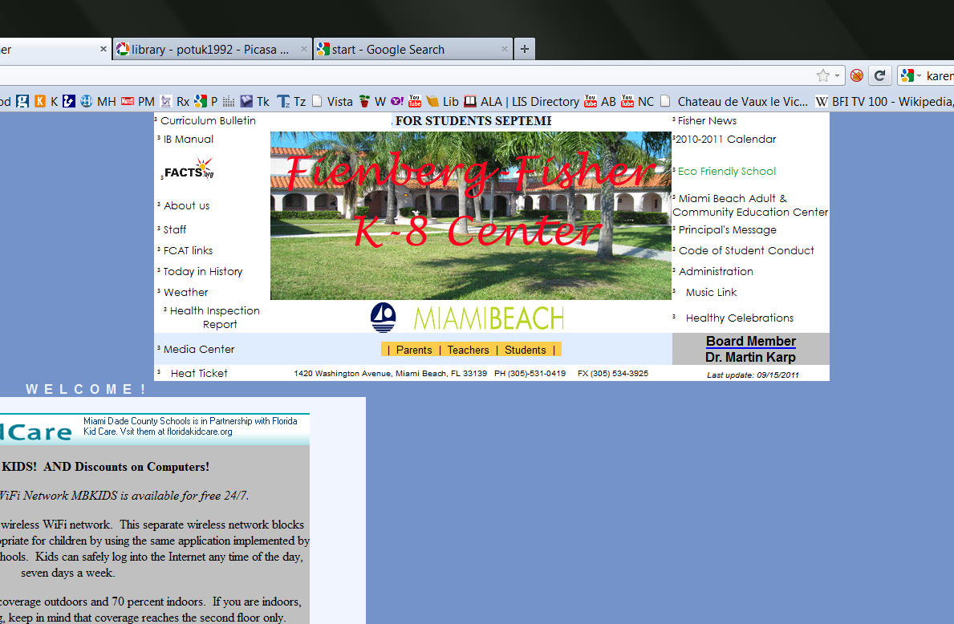
Look at the school website.

Slide 4
fienberg.dadeschools.net

Slide 5
Got it?
fienberg.dadeschools.net

Slide 6
Click on ‘Media Center’

Slide 7
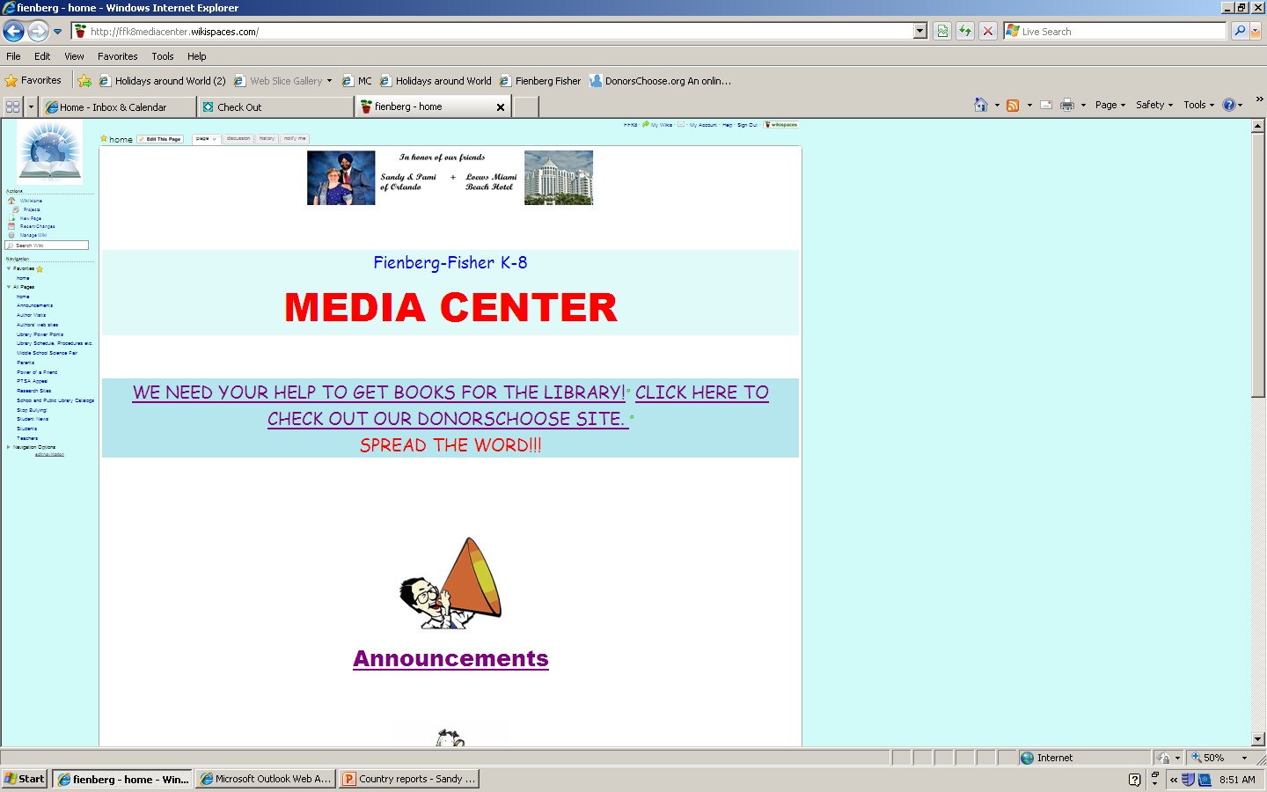
Now you’re at the Media Center home page

Slide 8
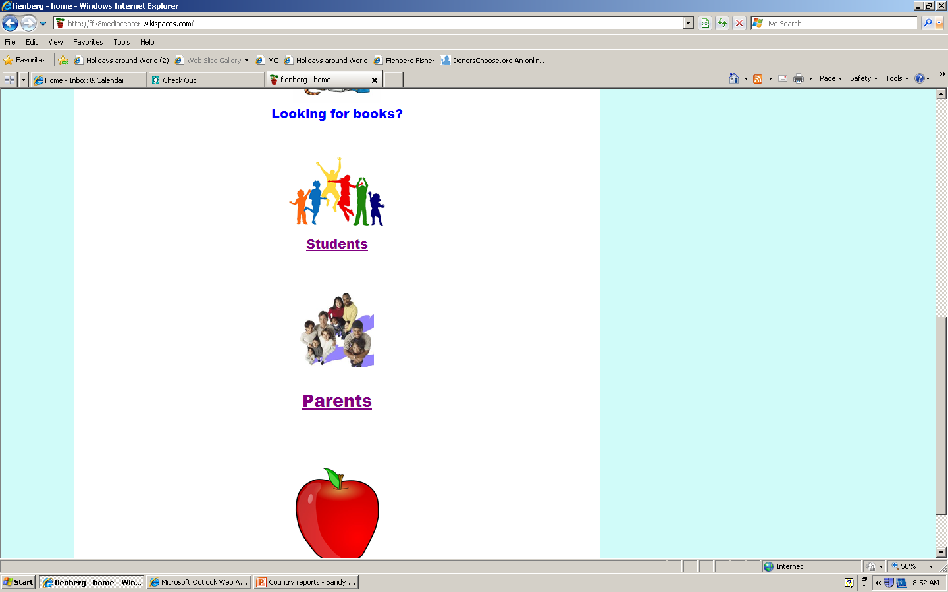
Scroll down and click on ‘Students’

Slide 9
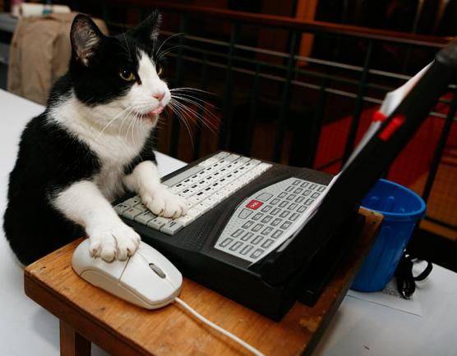
Now click on ‘Research’
Research

Slide 10

Before you go on…

Slide 11
Important! Important! Important!
If you go to these sites from home
you may need
a log-in name and a password.

Slide 12
Log-in =
miamidade

Slide 13
Password =
miamidade

Slide 14
O.K. So we clicked here, didn’t we?

Slide 15
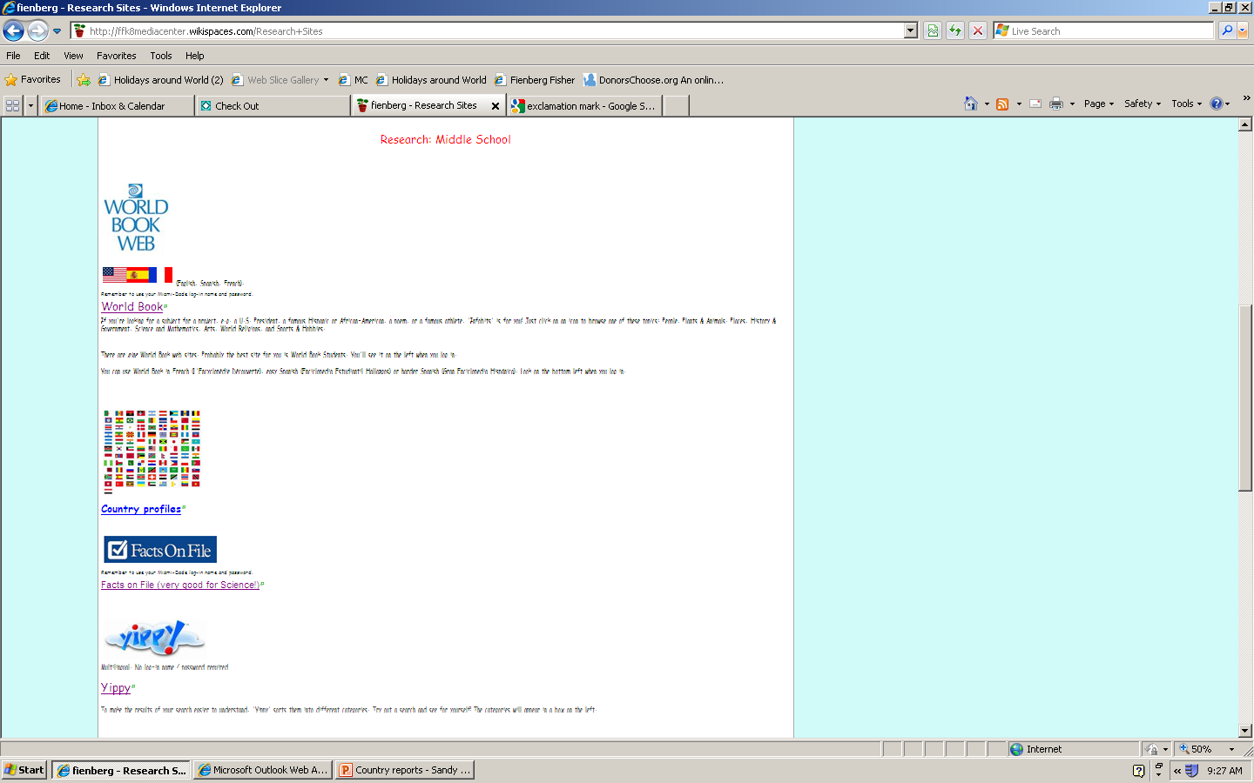

Scroll down to these 3 links
World Book Web
Country Profiles
Facts on File

Slide 16
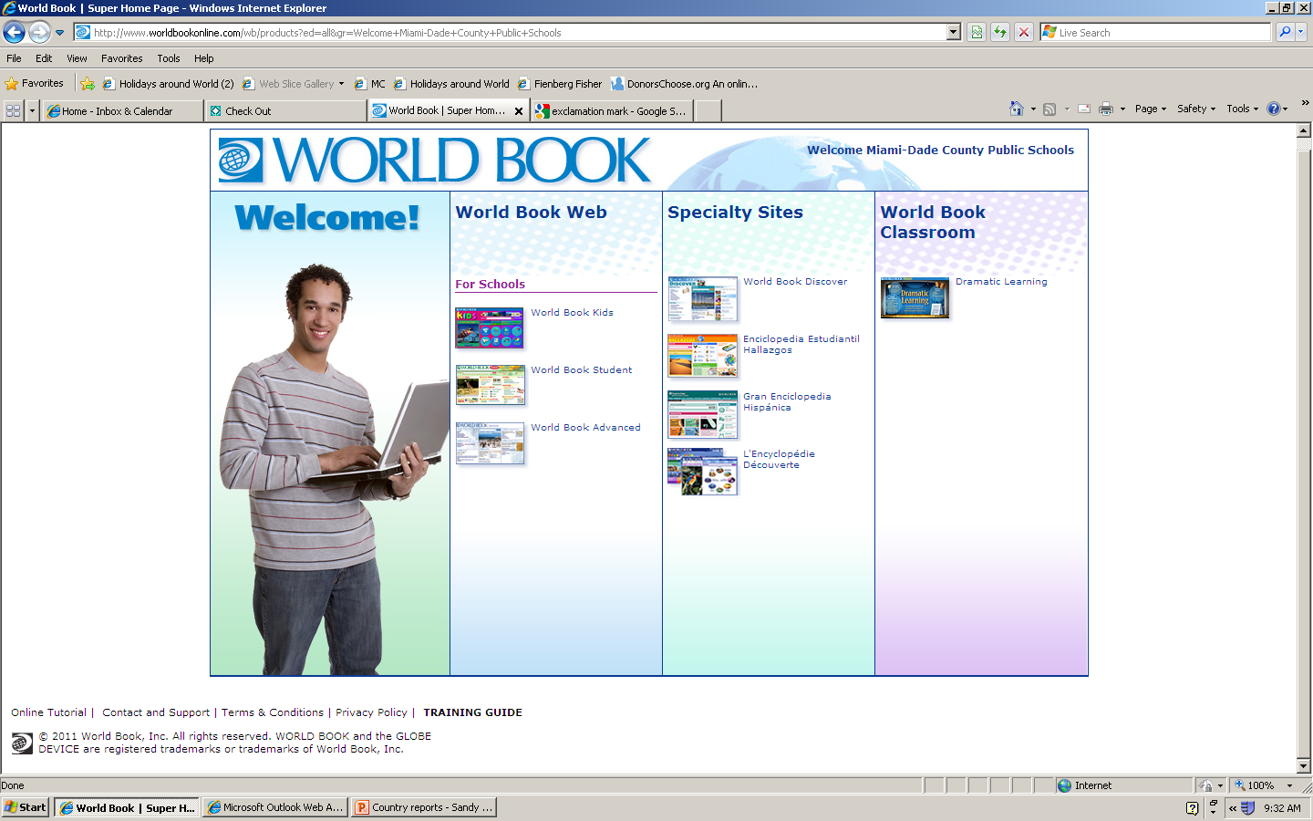
After you sign in to World Book Web….

Slide 17
You can get info on countries ….
HERE
(World
Book
Student)
OR HERE
(World
Book
Discover)

Slide 18
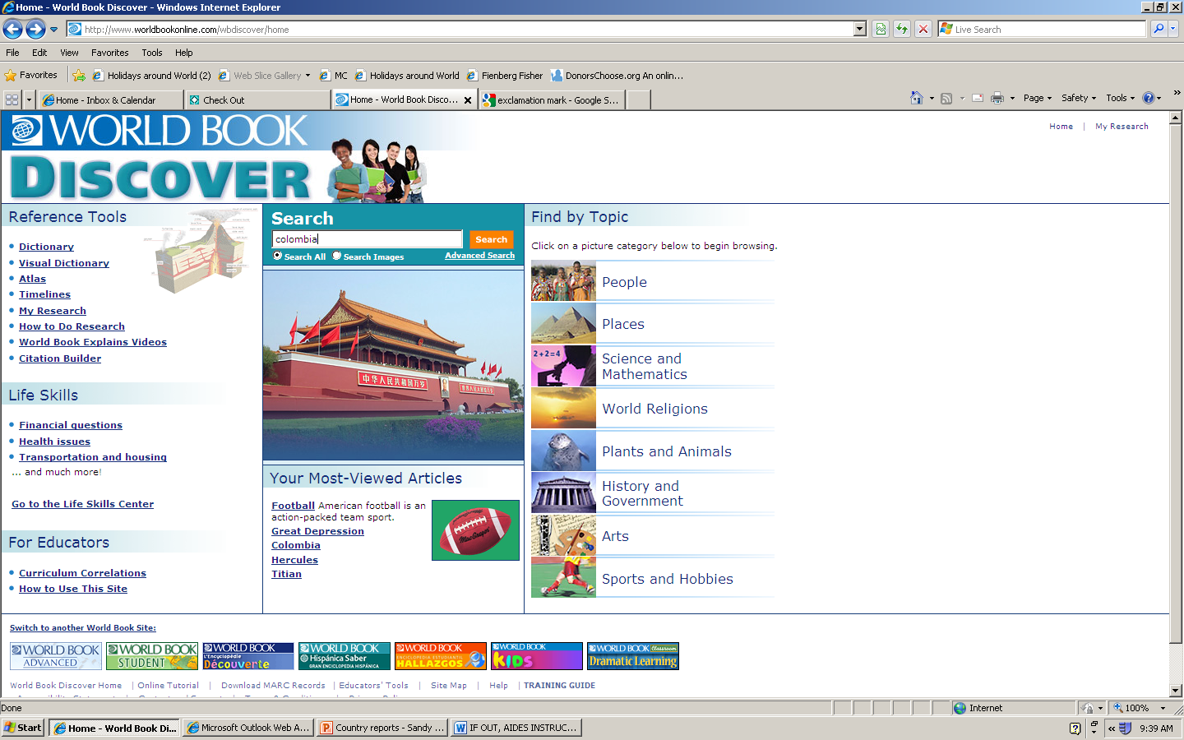
World Book Discover is probably the easiest site. Just type your country in the Search Bar and click

Slide 19
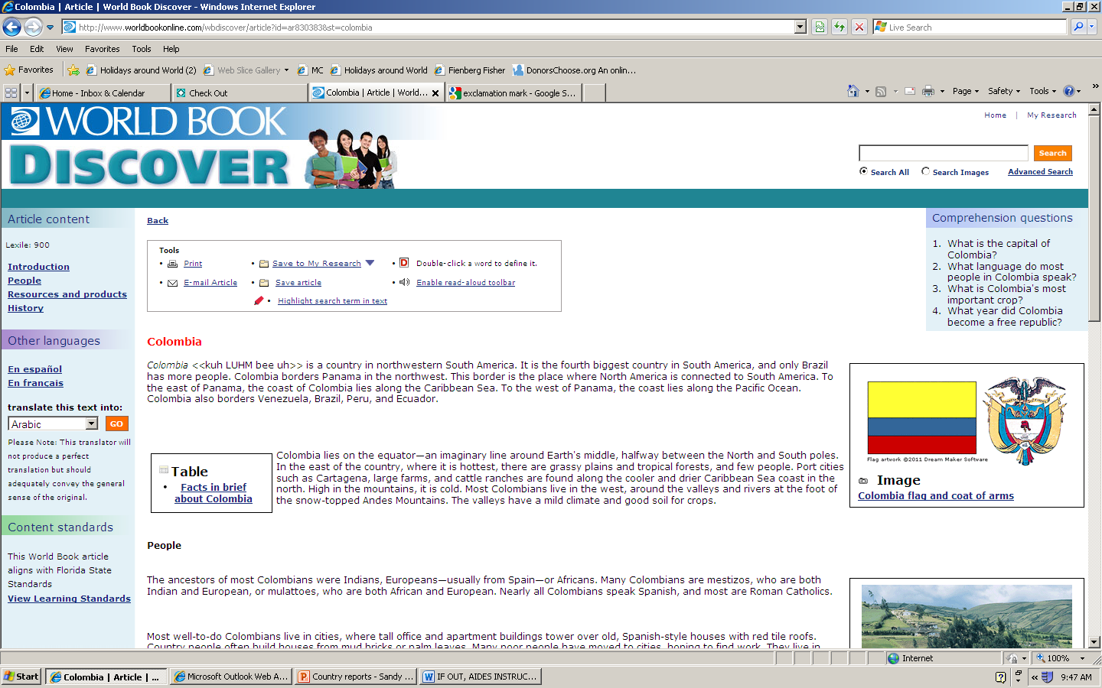
For quick info, see the ‘Facts in Brief’ table

Slide 20
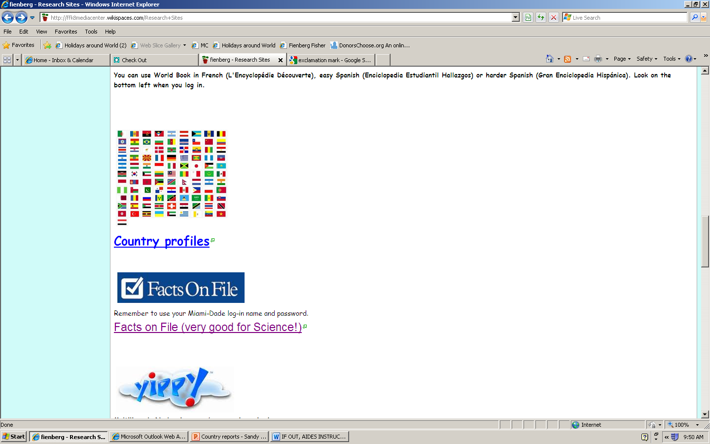
Remember that there are 2 other links you can go to

Slide 21
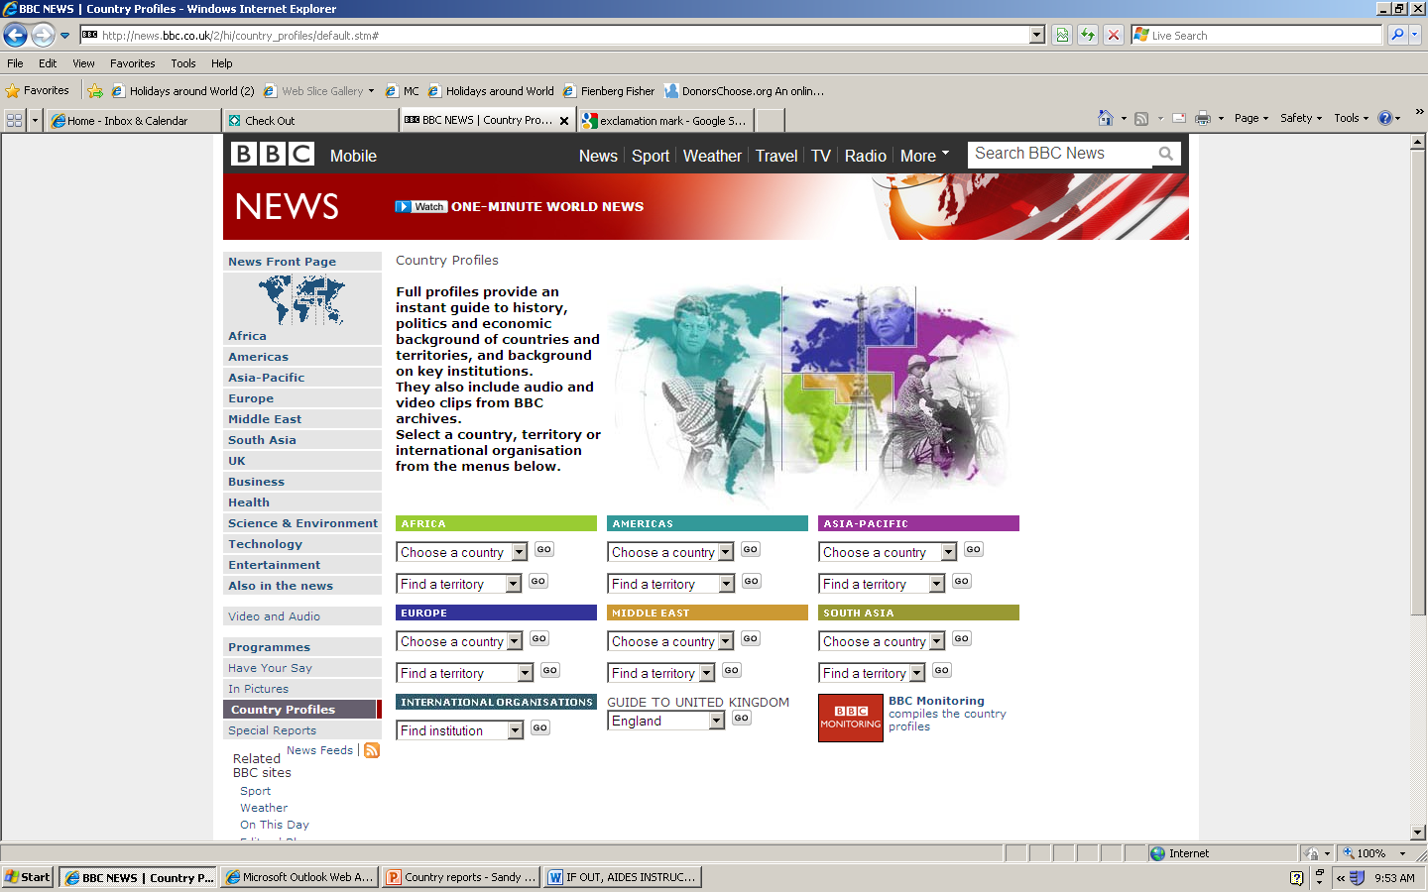
In ‘Country Profiles’, choose a country from the drop-down menu

Slide 22
‘Country Profiles’ is easy to use but it’s for adults. You may find the language difficult!

Slide 23
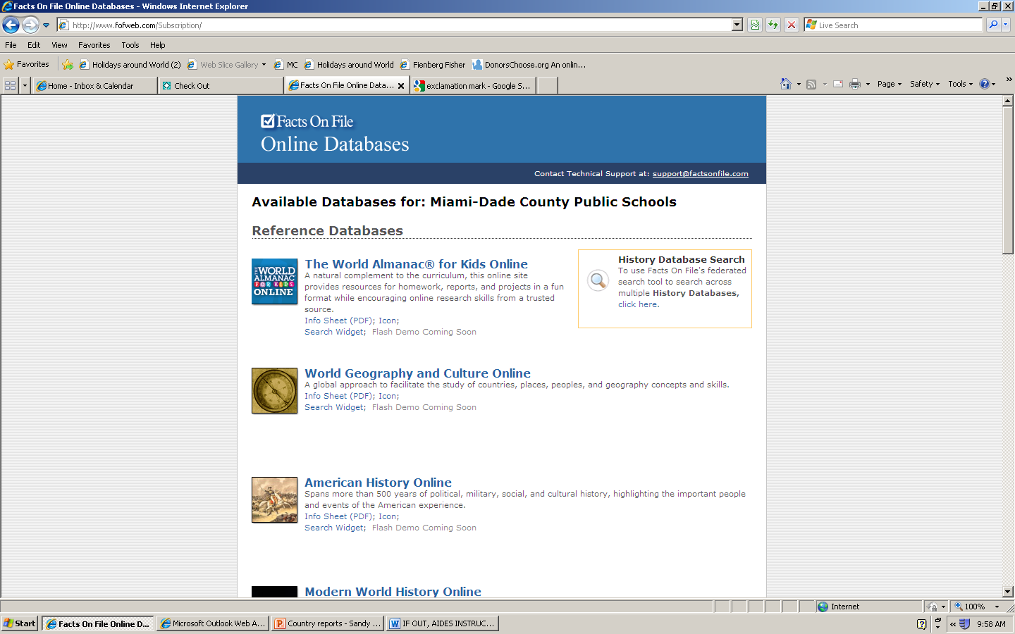
The last link is ‘Facts on File’. After you log in, you’ll see this page.
‘Facts on File’ is great for lots of subjects. It has really good science resources, for example. But, for info on countries, you should go here:
‘World Geography
and Culture online’

Slide 24
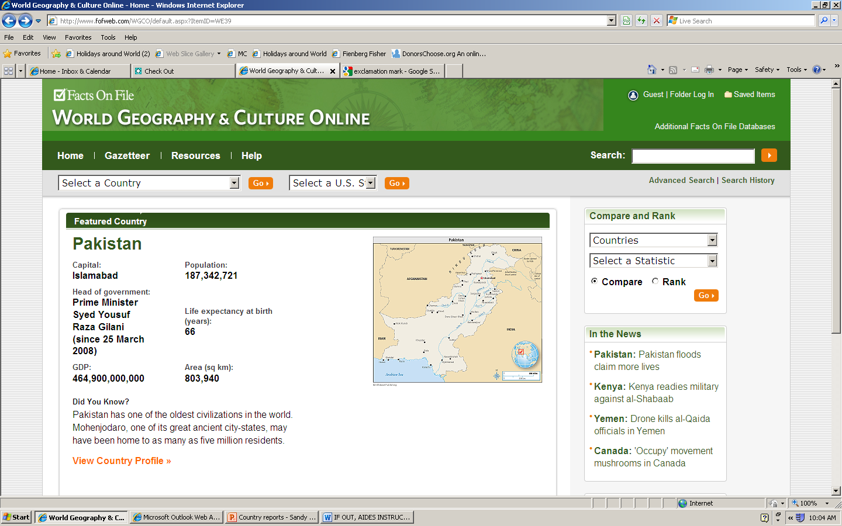

Choose a country from the drop-down menu, then look at the Country Profile.
Country
Country
profile

Slide 25
And that’s all you need to know…
These online resources are for YOU.
Use them from school, or from home.
Just remember THREE things…

Slide 26
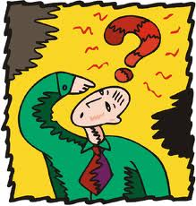
What’s the address of the school website?

Slide 27
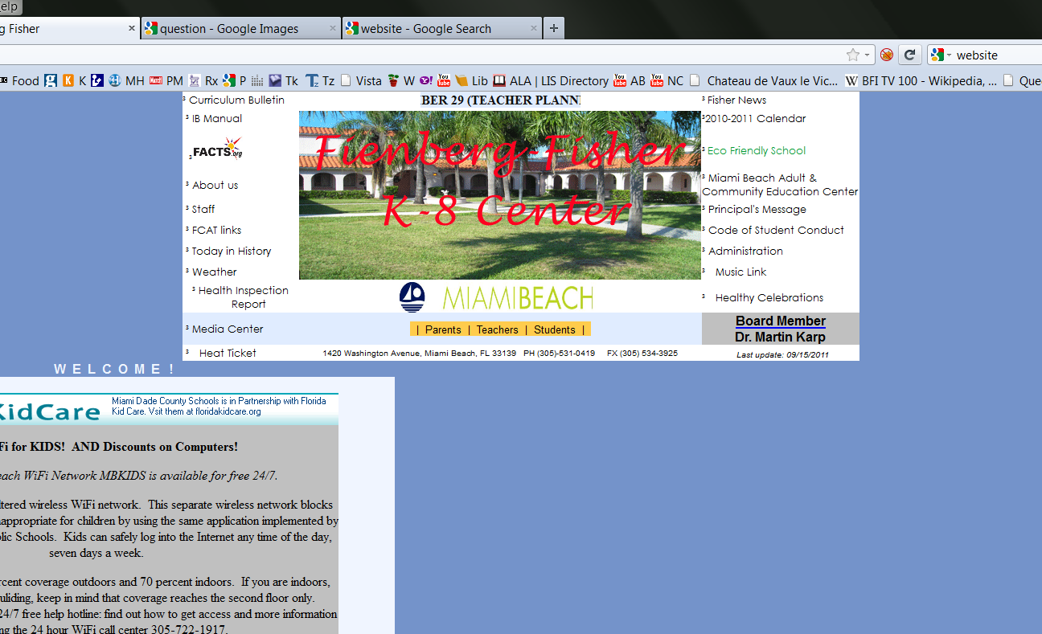
fienberg.dadeschools.net

Slide 28

What if they ask you for a log-in name?

Slide 29
What if they want a log-in name?
miamidade

Slide 30
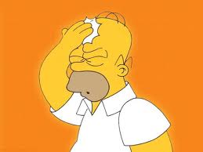
What if they want a password?

Slide 31
What if they want a password?
miamidade

Slide 32


Slide 34


Slide 35


Slide 36


Slide 37


